Slide 1
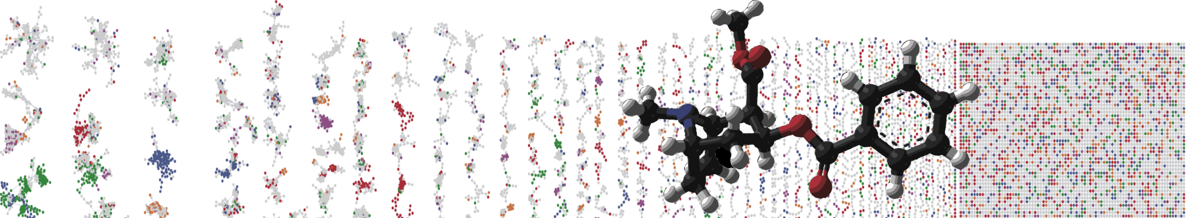


Molecular networking with the Global Natural Products Social Networking (GNPS) platform
ENTER AUTHORS HERE
University of California - San Diego

Slide 2
Objectives and Data
Utilize GNPS online interface
Explore library identifications
Explore molecular network to discover new bile acids
Link to the GNPS job: https://gnps.ucsd.edu/ProteoSAFe/status.jsp?task=5a18a7a0b96447d7abdbb73fee09ecdb
Interactive Link

Slide 3
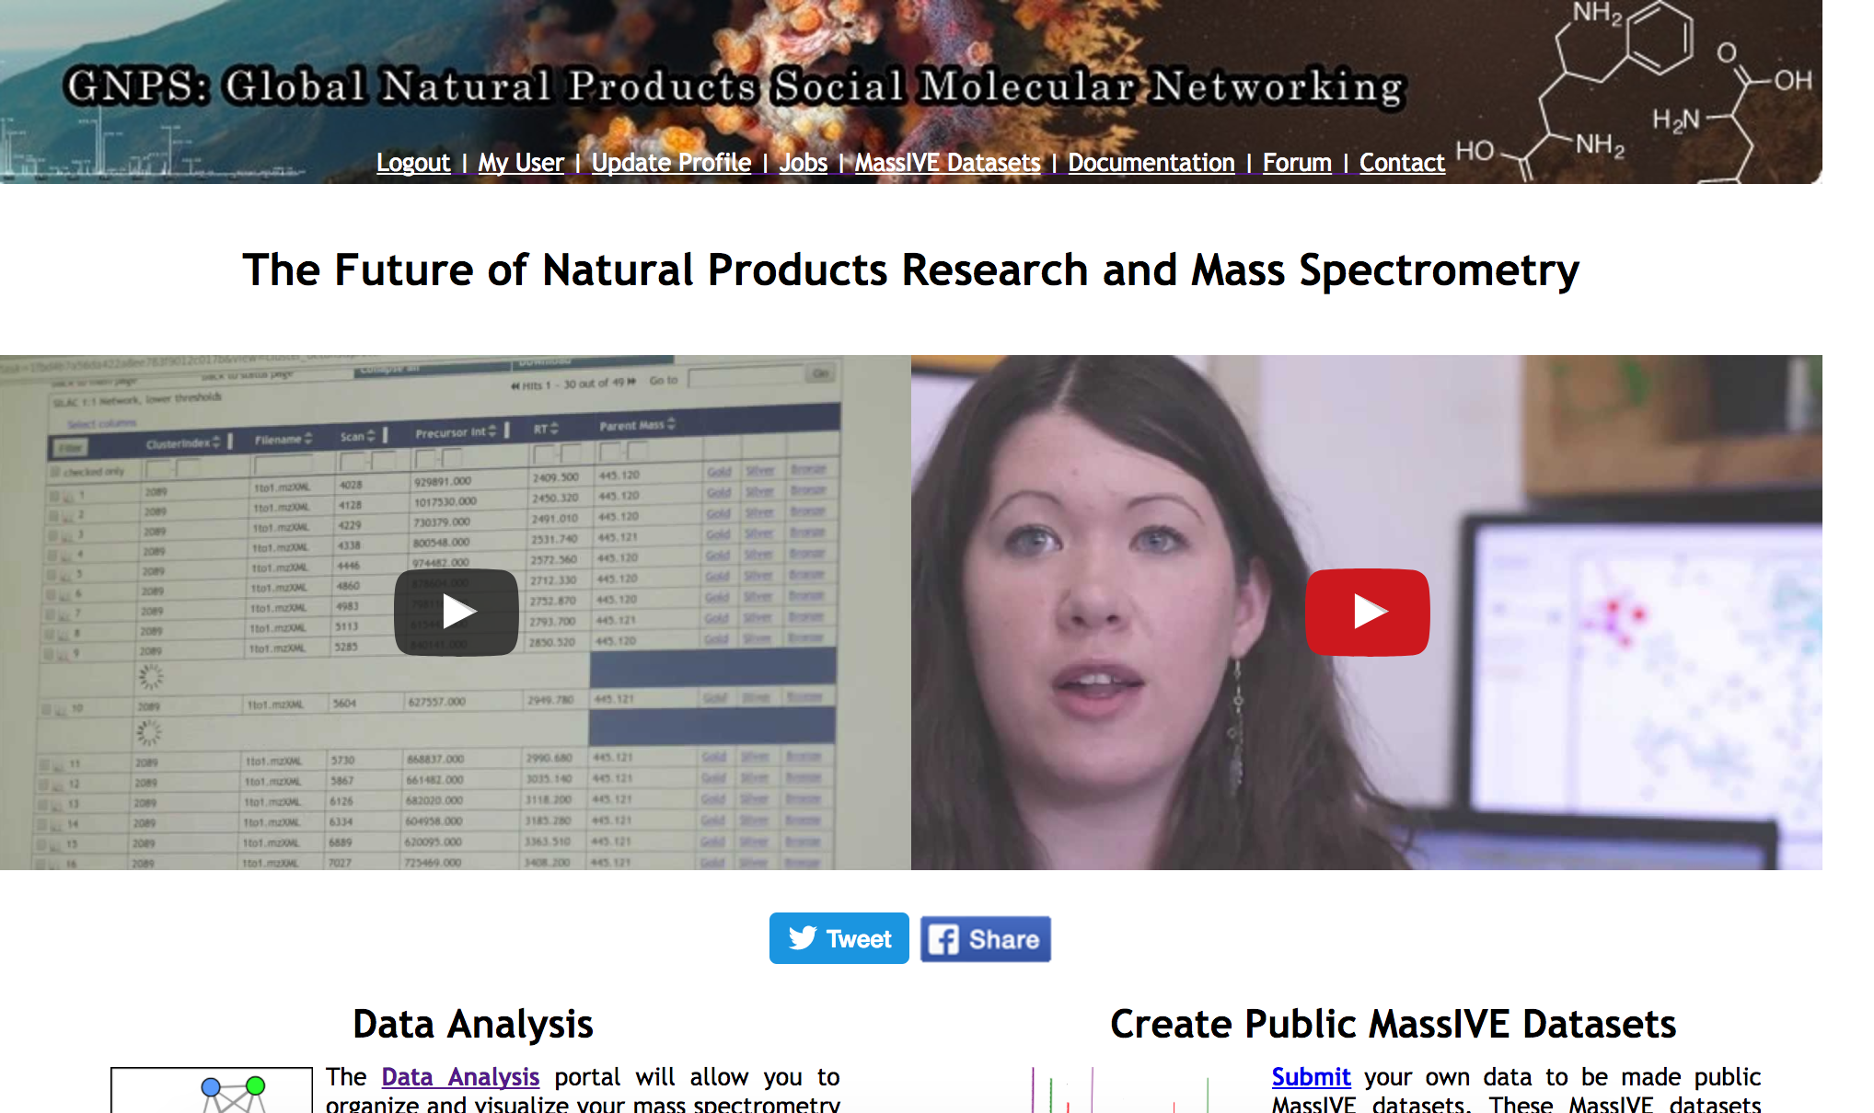
Lets analyze your molecular network.

Slide 4
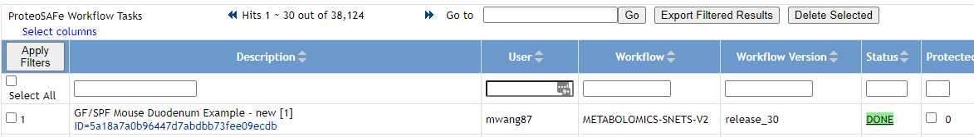
Select Done Job
Interactive Link

Slide 5
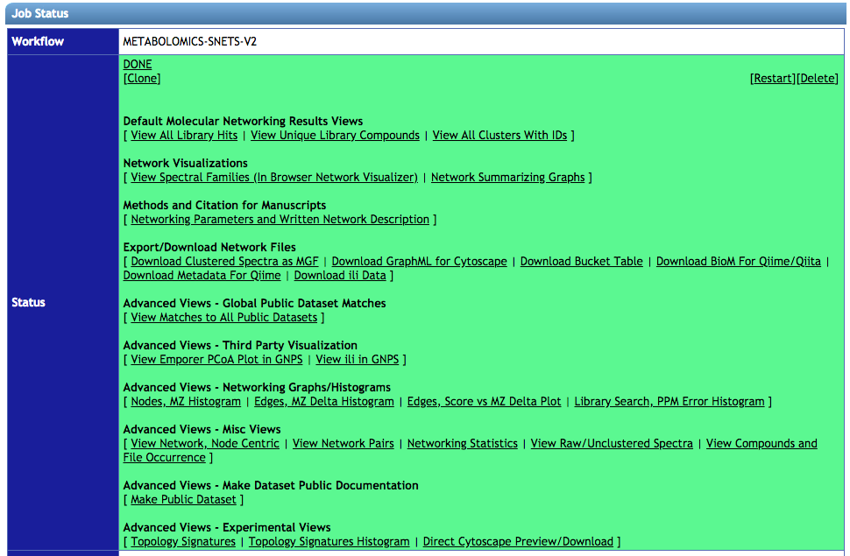
Explore Known Compounds
Interactive Link

Slide 6
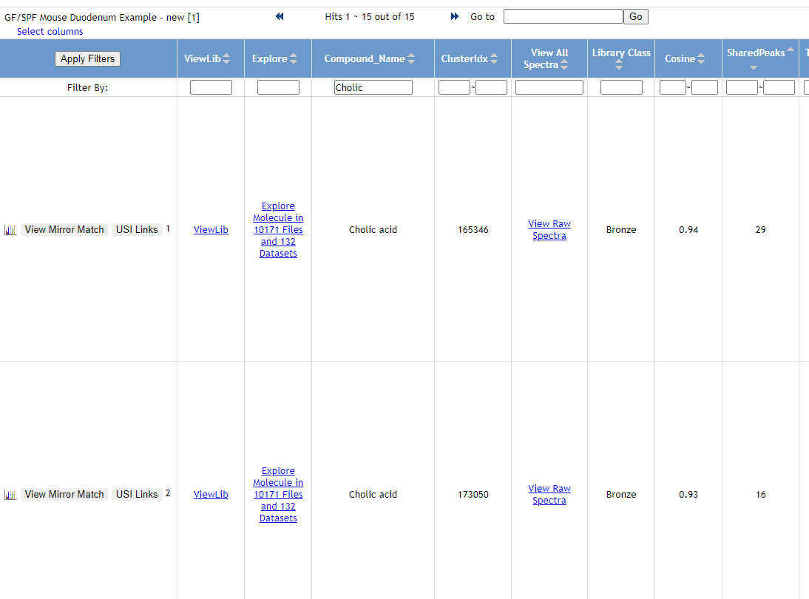
Find Various Bile Acids
Interactive Link

Slide 7
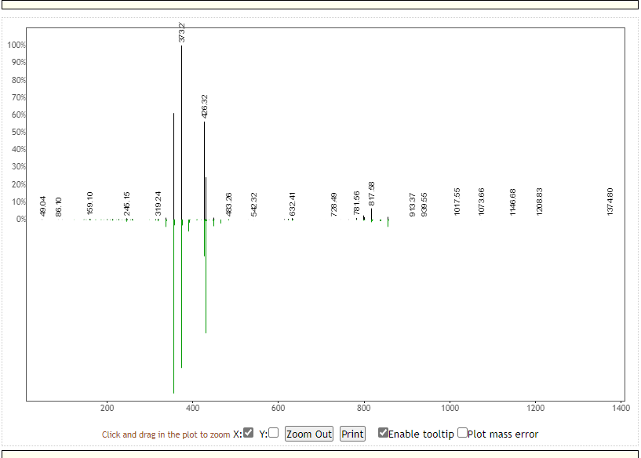
Visualize MS/MS Match

Slide 8
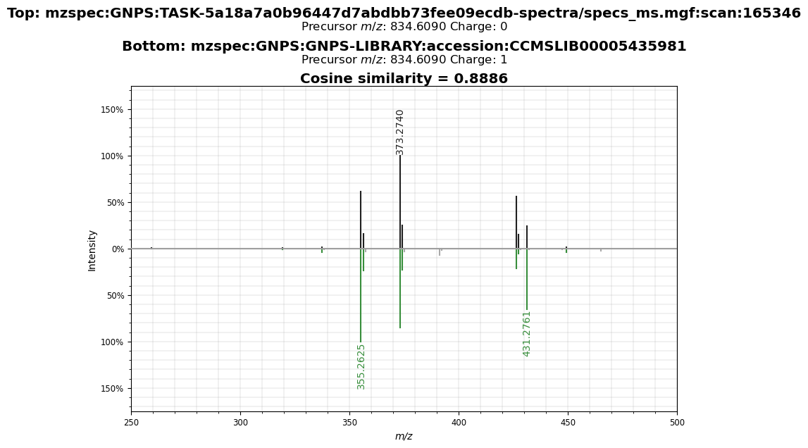
Visualize Pretty MS/MS Match
Interactive Link

Slide 9
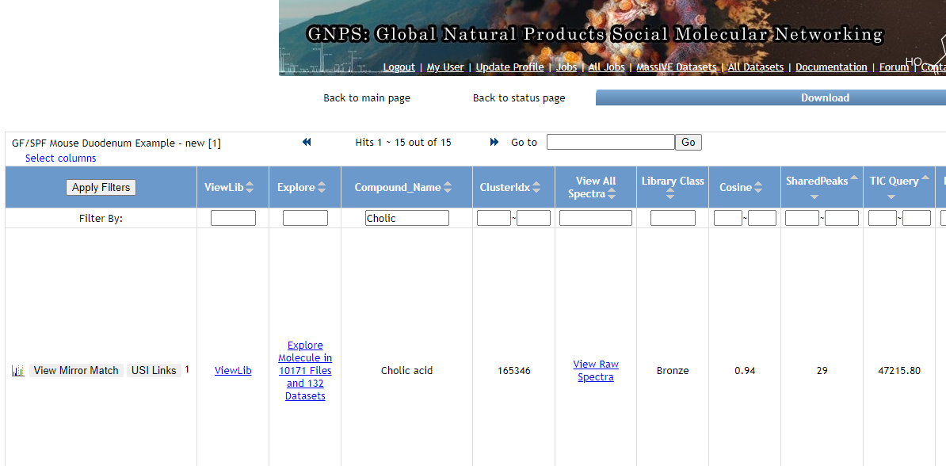

Slide 10
Explore Molecular Networks
Interactive Link

Slide 11
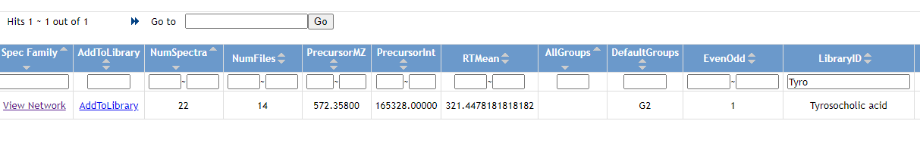
Explore Network of Stenothricin
Search for “Tyro”
in the “LibraryID” column
Interactive Link

Slide 12
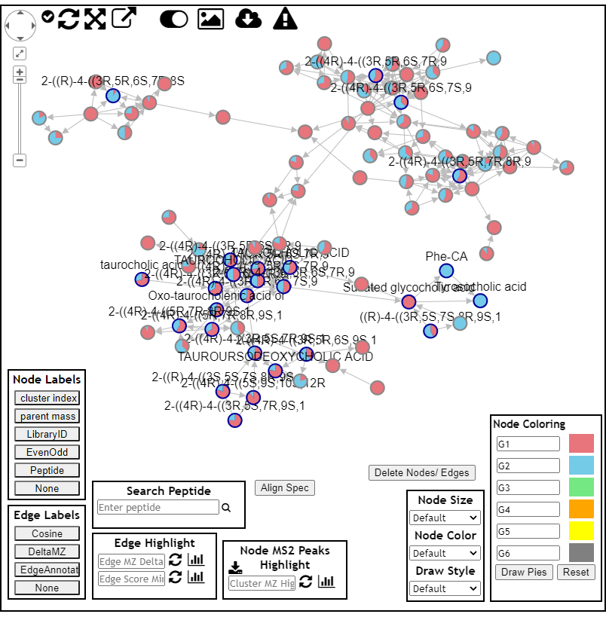
Explore Network of Conjugated
Cholic Acids
Germ Free in Red
Pathogen Specific in Blue
Interactive Link

Slide 13
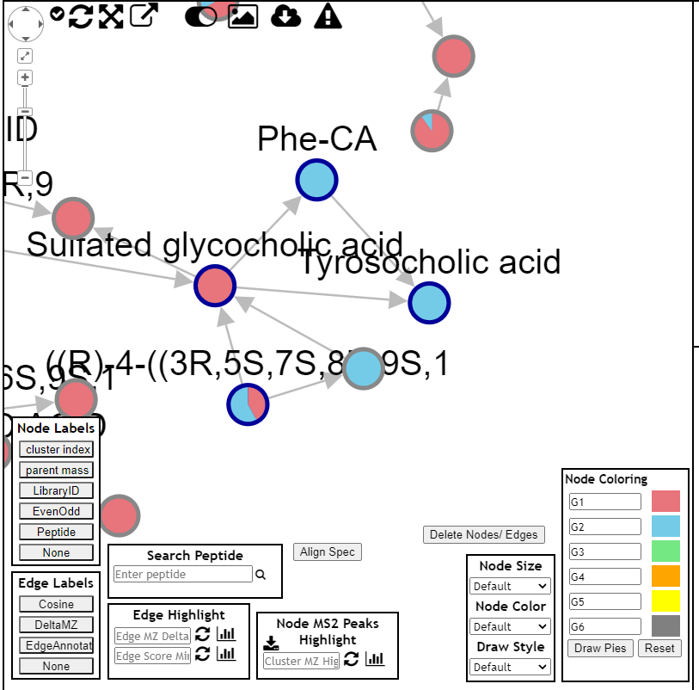
Explore Network of Stenothricin
Phenylaline Conjugated Cholic Acid and Tyrosine Conjugated Cholic Acid
Only in Pathogen Specific Mice
Interactive Link

Slide 14
Questions, Problems or Bugs?
Documentation: https://ccms-ucsd.github.io/GNPSDocumentation/
Forum: https://groups.google.com/forum/#!forum/molecular_networking_bug_reports
PRESENTER NAMES AND EMAILS HERE

